Slide 1

When We Face Rejection pt. 1 / Acts 13:13

Slide 2
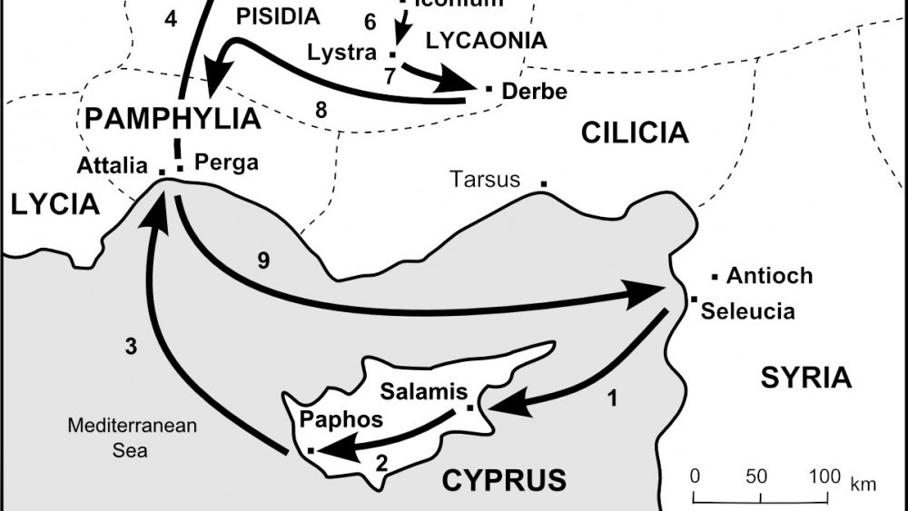

Slide 3

Act 13:13 Now when Paul and his company loosed from Paphos, they came to Perga in Pamphylia: and John departing from them returned to Jerusalem.

Slide 4
Why People Forsake
Spiritual Warfare?

Slide 5
Why People Forsake
Spiritual Warfare?
1Pe 5:8 Be sober, be vigilant; because your adversary the devil, as a roaring lion, walketh about, seeking whom he may devour:

Slide 6
Why People Forsake
Spiritual Warfare?
The Burden?
2Co 11:24 Of the Jews five times received I forty [stripes] save one. 25 Thrice was I beaten with rods, once was I stoned, thrice I suffered shipwreck, a night and a day I have been in the deep; 26 [In] journeyings often, [in] perils of waters, [in] perils of robbers, [in] perils by [mine own] countrymen, [in] perils by the heathen, [in] perils in the city, [in] perils in the wilderness, [in] perils in the sea, [in] perils among false brethren; …

Slide 7
Why People Forsake
Spiritual Warfare?
The Burden?
27 In weariness and painfulness, in watchings often, in hunger and thirst, in fastings often, in cold and nakedness. 28 Beside those things that are without, that which cometh upon me daily, the care of all the churches. 29 Who is weak, and I am not weak? who is offended, and I burn not? 30 If I must needs glory, I will glory of the things which concern mine infirmities.

Slide 8
Why People Forsake
Spiritual Warfare?
The Burden?
Immaturity?
Pro 3:35 The wise shall inherit glory: but shame shall be the promotion of fools.

Slide 9
Why People Forsake
Spiritual Warfare?
The Burden?
Immaturity?
Psa 75:5 Lift not up your horn on high: speak [not with] a stiff neck. 6 For promotion [cometh] neither from the east, nor from the west, nor from the south. 7 But God [is] the judge: he putteth down one, and setteth up another.

Slide 10

Key Point #1
We want God’s proving and God’s promotion – less pride.

Slide 11
People Will Forsake
Act 15:36 And some days after Paul said unto Barnabas, Let us go again and visit our brethren in every city where we have preached the word of the Lord, [and see] how they do. 37 And Barnabas determined to take with them John, whose surname was Mark. 38 But Paul thought not good to take him with them, who departed from them from Pamphylia, and went not with them to the work. 39 And the contention was so sharp between them, that they departed asunder one from the other: and so Barnabas took Mark, and sailed unto Cyprus; 40 And Paul chose Silas, and departed, being recommended by the brethren unto the grace of God. 41 And he went through Syria and Cilicia, confirming the churches.

Slide 12
Surrender, Faith & True Resolve
2Ti 1:8 Be not thou therefore ashamed of the testimony of our Lord, nor of me his prisoner: but be thou partaker of the afflictions of the gospel according to the power of God;
2Ti 4:5 But watch thou in all things, endure afflictions, do the work of an evangelist, make full proof of thy ministry.
1Co 13:7 Beareth all things, believeth all things, hopeth all things, endureth all things.

Slide 13
“When I left England, my hope of India's conversion was very strong; but amongst so many obstacles, it would die, unless upheld by God. Well, I have God, and His Word is true. Though the superstitions of the heathen were a thousand times stronger than they are, and the example of the Europeans a thousand times worse; though I were deserted by all and persecuted by all, yet my faith, fixed on the sure Word, would rise above all obstructions and overcome every trial. God's cause will triumph.”
- William Carey

Slide 14
Key Point #2
We must be faithful disciples of Christ in order to become fearless missionaries of Christ.

Slide 15
Surrender, Faith & True Resolve
2Ti 1:8 Be not thou therefore ashamed of the testimony of our Lord, nor of me his prisoner: but be thou partaker of the afflictions of the gospel according to the power of God;
2Ti 4:5 But watch thou in all things, endure afflictions, do the work of an evangelist, make full proof of thy ministry.
1Co 13:7 Beareth all things, believeth all things, hopeth all things, endureth all things.

Slide 16
Key Point #3
If we train leaders in our flesh then we will be blind to their weaknesses.

Slide 17
Key Point #4
Betrayal should NOT drive us to guard our hearts in fear of men but rather prepare our hearts in the fear of God.

Slide 18
“I seek at the beginning to get my heart into such a state that it has no will of its own in regard to a given matter. Nine-tenths of the trouble with people generally is just here. Nine-tenths of the difficulties are overcome when our hearts are ready to do the Lord's will, whatever it may be. When one is truly in this state, it is usually but a little way to the knowledge of what His will is.”
- George Mueller

