Slide 1

Establishing a Pattern of Ministry / Acts 14:1-7

Slide 2
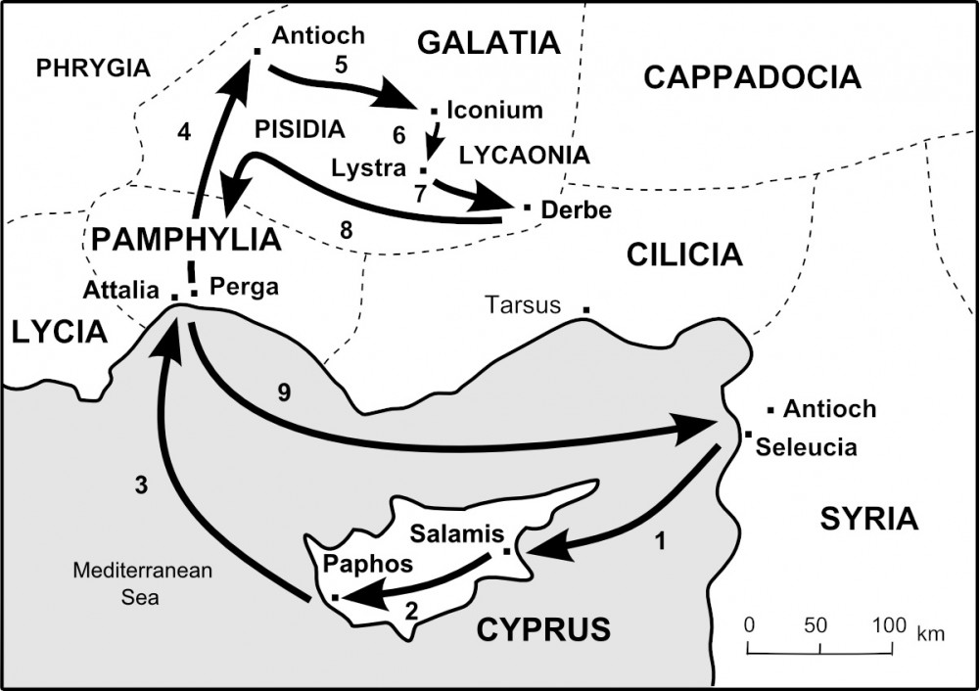

Slide 3

Acts 13:47 For so hath the Lord commanded us, [saying], I have set thee to be a light of the Gentiles, that thou shouldest be for salvation unto the ends of the earth. 48 And when the Gentiles heard this, they were glad, and glorified the word of the Lord: and as many as were ordained to eternal life believed. 49 And the word of the Lord was published throughout all the region.

Slide 4
50 But the Jews stirred up the devout and honourable women, and the chief men of the city, and raised persecution against Paul and Barnabas, and expelled them out of their coasts. 51 But they shook off the dust of their feet against them, and came unto Iconium. 52 And the disciples were filled with joy, and with the Holy Ghost.

Slide 5
Establishing a Pattern of Ministry / Acts 14:1-7

Slide 6
Will we establish patterns
in our own ministry?

Slide 7
The Pattern of Paul’s Platform
Act 14:1 And it came to pass in Iconium, that they went both together into the synagogue of the Jews, and so spake,

Slide 8

Key Point #1
Our platforms are the college campuses and workplaces where young people congregate.

Slide 9
The Pattern of Paul’s Preaching
Act 14:1 And it came to pass in Iconium, that they went both together into the synagogue of the Jews, and so spake,

Slide 10
Key Point #2
Our pattern must include the faith to speak up.

Slide 11
“It makes me boil when I think of the power we profess and the utter impotency of our action. Believers who know one-tenth as much as we do are doing one-hundred times more for God, with His blessing and our criticism. Oh if I could write it, preach it, say it, paint it, anything at all, if only God’s power would become known among us.”
― Jim Elliot, Missionary to Ecuador & Martyr for Christ

Slide 12
The Pattern of Prayer
Col 4:2 Continue in prayer, and watch in the same with thanksgiving; 3 Withal praying also for us, that God would open unto us a door of utterance, to speak the mystery of Christ, for which I am also in bonds: 4 That I may make it manifest, as I ought to speak.

Slide 13
The Pattern of Prayer
Eph 6:18 Praying always with all prayer and supplication in the Spirit, and watching thereunto with all perseverance and supplication for all saints; 19 And for me, that utterance may be given unto me, that I may open my mouth boldly, to make known the mystery of the gospel, 20 For which I am an ambassador in bonds: that therein I may speak boldly, as I ought to speak.

Slide 14
The Pattern of Prayer
2Th 3:1 Finally, brethren, pray for us, that the word of the Lord may have [free] course, and be glorified, even as [it is] with you: 2 And that we may be delivered from unreasonable and wicked men: for all [men] have not faith.

Slide 15
Key Point #3
Our pattern must include
a team of prayer warriors.

Slide 16
The Pattern of Paul’s Discipleship
Act 14:2 But the unbelieving Jews stirred up the Gentiles, and made their minds evil affected against the brethren.3 Long time therefore abode they speaking boldly in the Lord, which gave testimony unto the word of his grace, and granted signs and wonders to be done by their hands.

Slide 17
Key Point #4
Our pattern is only as complete as
our discipleship is effective.

Slide 18
The Pattern of the Pessimists
Act 14:2 But the unbelieving Jews stirred up the Gentiles, and made their minds evil affected against the brethren.3 Long time therefore abode they speaking boldly in the Lord, which gave testimony unto the word of his grace, and granted signs and wonders to be done by their hands.

Slide 19
Key Point #5
The pattern of the enemy is
to divide and disarm.

Slide 20
The Pattern of the Pessimists
5 And when there was an assault made both of the Gentiles, and also of the Jews with their rulers, to use [them] despitefully (insult), and to stone them,
1Co 16:8 But I will tarry at Ephesus until Pentecost. 9 For a great door and effectual is opened unto me, and [there are] many adversaries. 2 But the unbelieving Jews stirred up the Gentiles, and made their minds evil affected against the brethren.

Slide 21
The Pattern Repeats
6 They were ware of [it], and fled unto Lystra and Derbe, cities of Lycaonia, and unto the region that lieth round about: 7 And there they preached the gospel.

