Slide 1

Establishing a Pattern of Ministry pt 2 / Acts 14:1-7

Slide 2
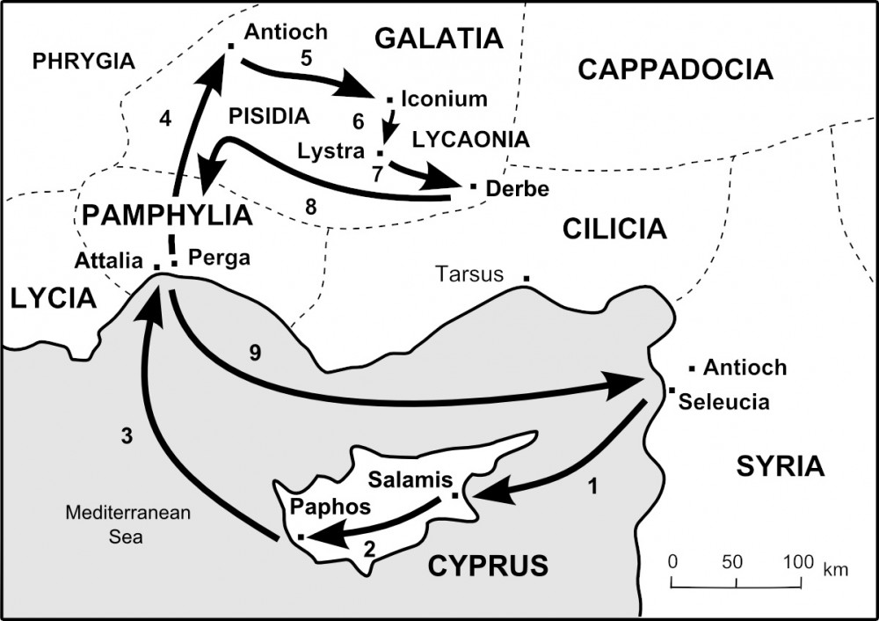

Slide 3
Establishing a Pattern of Ministry pt 2 / Acts 14:1-7

Slide 4

Gal 5:4 Christ is become of no effect unto you, whosoever of you are justified by the law; ye are fallen from grace. 5 For we through the Spirit wait for the hope of righteousness by faith. 6 For in Jesus Christ neither circumcision availeth any thing, nor uncircumcision; but faith which worketh by love.

Slide 5
1Co 11: 1 Be ye followers of me, even as I also [am] of Christ.

Slide 6
What is the pattern of ministry that I am building?

Slide 7
The Pattern of Paul’s Platform
Act 14:1 And it came to pass in Iconium, that they went both together into the synagogue of the Jews, and so spake,

Slide 8
The Pattern of Paul’s Platform
Act 14:1 And it came to pass in Iconium, that they went both together into the synagogue of the Jews, and so spake,
Our platforms are the college campuses and workplaces where young people congregate.

Slide 9
The Pattern of Paul’s Preaching
Act 14:1 And it came to pass in Iconium, that they went both together into the synagogue of the Jews, and so spake,

Slide 10
The Pattern of Paul’s Preaching
Act 14:1 And it came to pass in Iconium, that they went both together into the synagogue of the Jews, and so spake,
Our pattern must include the faith to speak up.

Slide 11
The Pattern of Paul’s Prayer
Eph 6:18 Praying always with all prayer and supplication in the Spirit, and watching thereunto with all perseverance and supplication for all saints;
1Th 5:17 Pray without ceasing.

Slide 12
The Pattern of Paul’s Prayer
Eph 6:18 Praying always with all prayer and supplication in the Spirit, and watching thereunto with all perseverance and supplication for all saints;
1Th 5:17 Pray without ceasing.
Doing “what’s right” can’t be right if you exclude God from the process.

Slide 13
The Pattern of Paul’s Discipleship
Act 14:2 But the unbelieving Jews stirred up the Gentiles, and made their minds evil affected against the brethren.3 Long time therefore abode they speaking boldly in the Lord, which gave testimony unto the word of his grace, and granted signs and wonders to be done by their hands.

Slide 14
2Ti 2:2 And the things that thou hast heard of me among many witnesses, the same commit thou to faithful men, who shall be able to teach others also.

Slide 15

Key Point #4
Our pattern is only as complete as
our discipleship is effective.

Slide 16
The Pattern of the Pessimists
Act 14:2 But the unbelieving Jews stirred up the Gentiles, and made their minds evil affected against the brethren.3 Long time therefore abode they speaking boldly in the Lord, which gave testimony unto the word of his grace, and granted signs and wonders to be done by their hands.

Slide 17
Key Point #5
The pattern of the enemy is
to divide and disarm.

Slide 18
The Pattern of the Pessimists
5 And when there was an assault made both of the Gentiles, and also of the Jews with their rulers, to use [them] despitefully (insult), and to stone them,
1Co 16:8 But I will tarry at Ephesus until Pentecost. 9 For a great door and effectual is opened unto me, and [there are] many adversaries. 2 But the unbelieving Jews stirred up the Gentiles, and made their minds evil affected against the brethren.

Slide 19
“One of the most accurate ways to detect and measure the activity of God is to note the amount of opposition that is present.”
Nik & Ruth Ripken,
Missionaries to East Africa

Slide 20
“God glories to dispatch His people into the depths of a fallen world where suffering is the standard system. He revels not in the affliction of His people but in their potential to overcome the kingdom of darkness.”
Nik & Ruth Ripken
Missionaries to East Africa

Slide 21
The Pattern Repeats
6 They were ware of [it], and fled unto Lystra and Derbe, cities of Lycaonia, and unto the region that lieth round about: 7 And there they preached the gospel.

