Slide 1

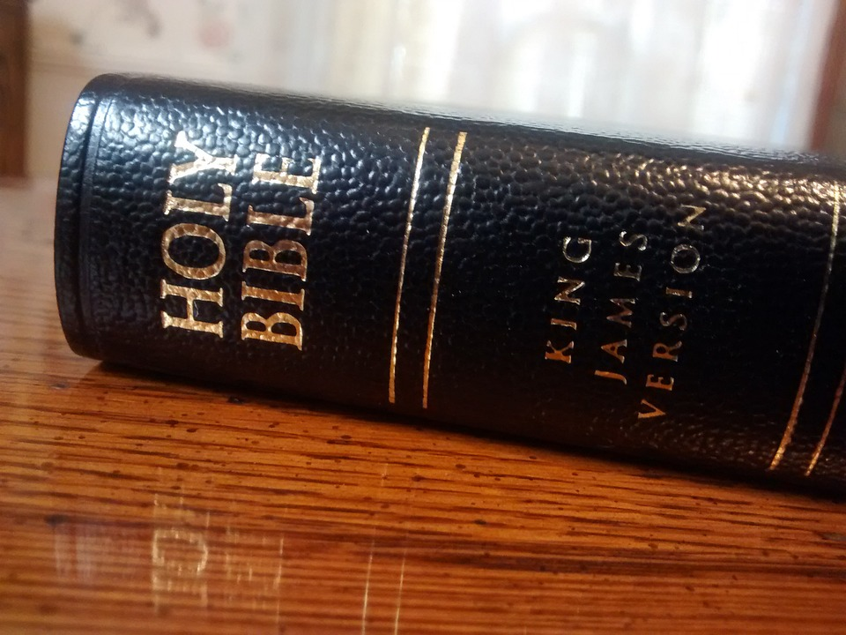
Discovery Bible Study Method
A how to guide

Slide 2

Do you even read Bro?

Slide 3
a. You can’t begin to study the Word until you have begun to read it…

Slide 4
II. What is Discovery Bible Study?

Slide 5
a. It is a method of looking at the Bible in a group that allows the Bible to be the Authority and the Holy Spirit the teacher.
i. Not Preaching, but a discussion about what the Bible says
ii. Works even with people who are unsaved or unfamiliar with the Bible
b. Not rocket science

Slide 6
III. Start here

Slide 7

a. Read the Passage for Yourself First
i. At least 10 times, but 20 – 30 is ideal
1. BEFORE YOU DO ANYTHING ELSE
2. STOP, DID YOU EVEN READ IT???!!!
ii. Why is this important?

Slide 8


a. Write or type out the passage
i. This allows you to see
1. Each word individually
2. Each punctuation individually
3. Each sentence individually
4. Each verse individually
5. The entire passage

Slide 9
Isa 55:11 So shall my word be that goeth forth out of my mouth: it shall not return unto me void, but it shall accomplish that which I please, and it shall prosper in the thing whereto I sent it.

Slide 10
2Ti 2:15 Study to shew thyself approved unto God, a workman that needeth not to be ashamed, rightly dividing the word of truth.

Slide 11
IV. THE DISCOVERY BIBLE METHOD!!!
The steps of running a Group Bible study

Slide 12
a. It consists of 5 steps:
i. Solo Reading
1. Each person in the Group reads it silently

Slide 13
a. It consists of 5 steps:
ii. Loud Reading
1. Read one verse per person going around the group until the whole passage has been read

Slide 14
a. It consists of 5 steps:
iii. Discovering the Theme
1. Sum up the central idea of the passage in a few words
a. You let anyone in the Group to try and say the theme in their own words.
b. Never discourage anyone - Eph 4:29 Let no corrupt communication proceed out of your mouth, but that which is good to the use of edifying, that it may minister grace unto the hearers.
Notes:
Edifying - Building up in christian knowledge; instructing; improving the mind.

Slide 15
a. It consists of 5 steps:
iii. Discovering the Theme cont.
Helps:
Look for repeated words, phrases, or ideas
EX. Romans 8
It has 266 unique words - 903 total words
Spirit is mentioned 21 times
The 76; of 38; for 32; that 27
Look for a purpose statement by the author.
Luke 1:1-4

Slide 16
a. It consists of 5 steps:
iv. Dissection
1. Go through each verse and discuss what the BIBLE is saying
2. Use questions to help guide the discussion
a. Remember – some of the people in the group may know nothing about the Bible, encourage them for speaking
b. Keep the following in Mind while guiding the discussion
i. Context
ii. The theme

Slide 17
a. It consists of 5 steps:
V. Application
1. Each person looks at the passage and shares how they can apply this to their life
a. Remember the 3 Applications
i. Historical
ii. Doctrinal
iii. Personal/Inspirational/Devotional
b. What is your take away?

Slide 18

Small Group Discovery Method Practicum
You will get into a Group of 5 and take turns running the study by asking questions to help everyone participate. The Counselors will be around to answer questions.
Psalm 100

