Slide 1
The Christian Walk
1 Thessalonians 2:10-12

Slide 2
Outline
Verse 10: Holily, Justly, and Unblameably
Verse 11: Exhorting, comforting, and charging
Verse 12: Worthy

Slide 3
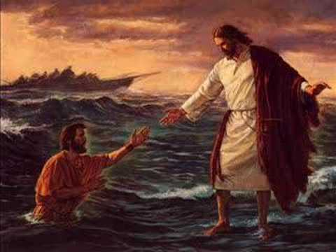
Point I
The way I walk matters to me

Slide 4
Holily
1 Peter 2:15-16 For so is the will of God, that with well doing ye may put to silence the ignorance of foolish men: As free, and not using your liberty for a cloke of maliciousness, but as the servants of God.
Ex 22:31a And ye shall be holy men unto me:

Slide 5
Liberty is to deliver you from the law; not deliver you unto your flesh.
Holiness means: “__________”

Slide 6
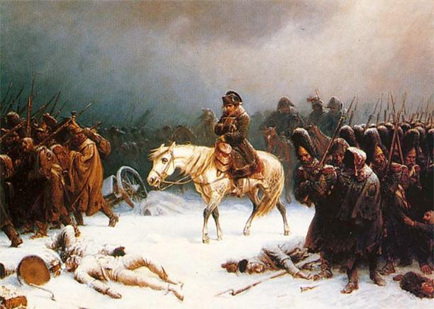
When I use my “liberty” to be anything but holy, I am driving a wedge between myself and what Christ has called me to be.

Slide 7
Q: Am I walking “set-apart”?

Slide 8
B. Justly
Micah 6:8 He hath shewed thee, O man, what is good; and what doth the LORD require of thee, but to do justly, and to love mercy, and to walk humbly with thy God?
Luke 23:41 And we indeed justly; for we receive the due reward of our deeds: but this man hath done nothing amiss.

Slide 9
Following Christ means that you always have eyes on you. When no human eye is able, God himself is watching.
To be “just” goes hand in hand with being a person on “integrity”

Slide 10
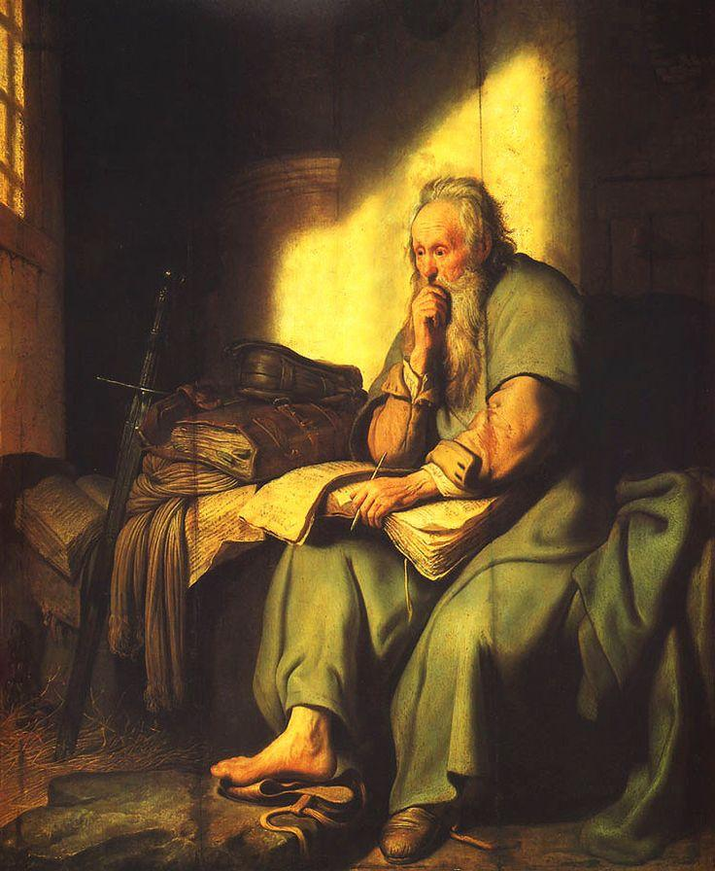
Psalm 119:45
And I will walk at liberty: for I seek thy precepts

Slide 11
True freedom can only be found in following the Words of God.
Walking justly focuses my heart and sharpens my vision on my Savior.

Slide 12
Q: Am I walking justly?

Slide 13
C. Unblameably
Luke 1:6 And they were both righteous before God, walking in all the commandments and ordinances of the Lord blameless.
Phil 2:15 That ye may be blameless and harmless, the sons of God, without rebuke, in the midst of a crooked and perverse nation, among whom ye shine as lights in the world;

Slide 14
The place we dwell is indeed crooked and perverse; the similarity and friendliness we have for it only falls out to our harm.
The way you walk sends a message to the worldly and unjust.

Slide 15
1 Tim 3:10 And let these also first be proved; then let them use the office of a deacon, being found blameless.
2 Peter 3:14 Wherefore, beloved, seeing that ye look for such things, be diligent that ye may be found of him in peace, without spot, and blameless.

Slide 16
The world is trying to find blame in you, to vindicate itself from “your” truth.
The world, the flesh, and the devil are doing a good enough job attacking you, we don’t need to add “blame” to the fire.

Slide 17
Q: Am I walking blamelessly?

Slide 18
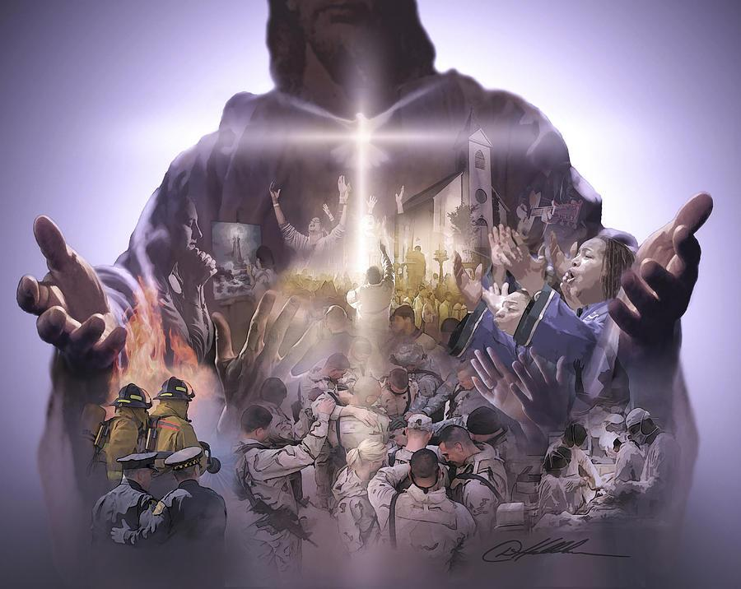
Point II
The way I walk matters to others

Slide 19
Exhortation
Acts 13:15 And after the reading of the law and the prophets the rulers of the synagogue sent unto them, saying, Ye men and brethren, if ye have any word of exhortation for the people, say on.
Acts 2:40 And with many other words did he testify and exhort, saying, Save yourselves from this untoward generation.

Slide 20
Exhorting is saying that fitly spoken word. It is taking the truth God spoke and sharing it.
If you leave a hangout and no word or form of exhortation happened you might re-examine what is is you are doing.

Slide 21
Q: Do I exhort my brothers and sisters?

Slide 22
B. Comfort
2 Thess 2:17 Comfort your hearts, and stablish you in every good word and work.
1 Thess 5:14 Now we exhort you, brethren, warn them that are unruly, comfort the feebleminded, support the weak, be patient towards all men.
1 Thess 5:11 Wherefore comfort yourselves together, and edify one another, even as also ye do.

Slide 23
cont.
Col 4:8 Whom I have sent unto you for the same purpose, that he might know your estate, and comfort your hearts;
2 Cor 7:13 Therefore we were comforted in your comfort: yeah, and exceedingly the more joyed we for the joy of Titus, because his spirit was refreshed by you all.

Slide 24
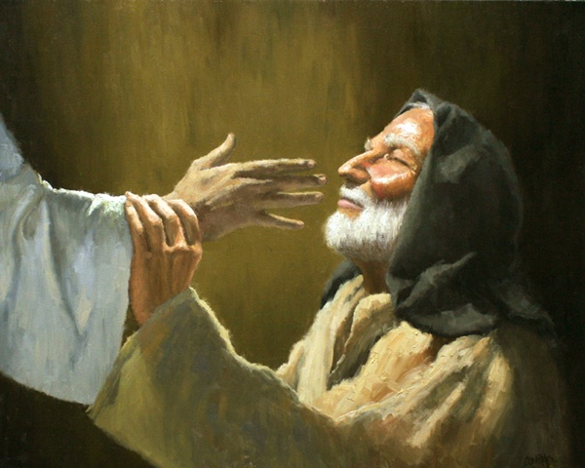
You have the power to refresh. You have the spirit in you to rejuvenate. Do not squander that.

Slide 25
Q: Do I comfort my brothers and sisters?

Slide 26
Q: Are we a family?

Slide 27
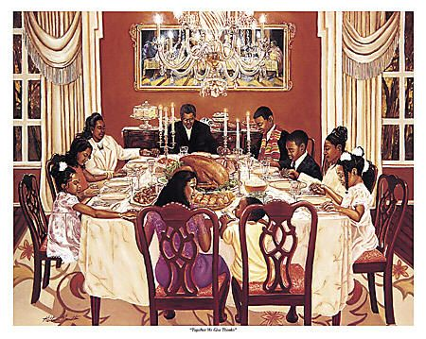
Family || Body
Family means sacrifice
Family means dying to self
Family means responsibility
Family means faithfulness
Family means accountability
Family means love

Slide 28
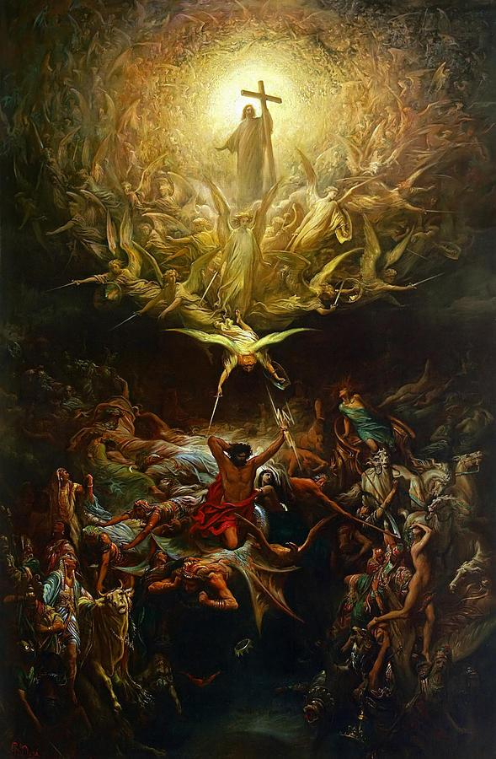
Point III
The way I walk matters to God

Slide 29
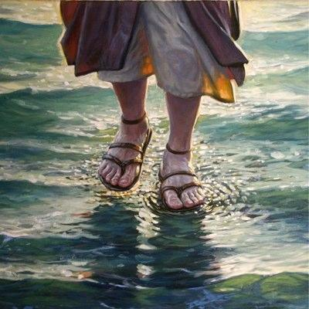
That we would walk worthy of God..
The enemy is attacking your walk

Slide 30
You have every tool to walk worthy of God, who hath called you

Slide 31
Psalm 73:1-17
A Psalm of Asaph. Truly God is good to Israel, even to such as are of a clean heart. But as for me, my feet were almost gone; my steps had well nigh slipped. For I was envious at the foolish, when I saw the prosperity of the wicked. For there are no bands in their death: but their strength is firm. They are not in trouble as other men; neither are they plagued like other men. Therefore pride compasseth them about as a chain; violence covereth them as a garment. Their eyes stand out with fatness: they have more than heart could wish. They are corrupt, and speak wickedly concerning opression: they speak loftily. They set their mouth against the heavens, and their tongue walketh through the earth. Therefore his people return hither: and waters of a full cup are wrung out to them.

Slide 32
cont
And they say, How doth God know? And is there knowledge in the most High? Behold, these are the ungodly, who prosper in the world; they increase in riches. Verily I have cleaned my heart in cain, and washed my hands in innocency. For all the day long have I been plagued, and chastened every morning. If I say, I will speak thus; behold, I should offend against the generation of thy children. When I thought to know this, it was too painful for me;
Until I went into the sanctuary of God; then understood I their end.

Slide 33
You will find every answer in the sanctuary.

Slide 34
Q: Am I walking worthy?

