Slide 1
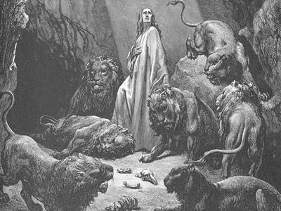
The Principle of being Predetermined
Daniel 3:18

Slide 2
Predetermined : Established or decided in advance
Daniel 3:18

Slide 3
Choosing Self

Slide 4
Choosing Self
Predetermined that you will never receive the truth that God has for you.

Slide 5
Choosing Self
John 19:15 But they cried out, Away with him, away with him, crucify him. Pilate saith unto them, Shall I crucify your King? The chief priests answered, We have no king but Caesar.

Slide 6
Choosing Self
1 Samuel 8:5-7 And said unto him, Behold, thou art old, and thy sons walk not in thy ways: now make us a king to judge us like all the nations. But the thing displeased Samuel, when they said, Give us a king to judge us. And Samuel prayed unto the LORD. And the LORD said unto Samuel, Hearken unto the voice of the people in all that they say unto thee: for they have not rejected thee, but they have rejected me, that I should not reign over them.

Slide 7
Reflection 1:
Believer, are you stubbornly rejecting truth that God has given you?

Slide 8
Choosing Self
2. Predetermined that you will compromise.

Slide 9
Choosing Self
Matthew 26:14-16 Then one of the twelve, called Judas Iscariot, went unto the chief priests, And said unto them, What will ye give me, and I will deliver him unto you? And they covenanted with him for thirty pieces of silver. And from that time he sought opportunity to betray him.

Slide 10
Choosing Self
Matthew 26:14-16 Then one of the twelve, called Judas Iscariot, went unto the chief priests, And said unto them, What will ye give me, and I will deliver him unto you? And they covenanted with him for thirty pieces of silver. And from that time he sought opportunity to betray him.
Jeremiah 17:9 The heart is deceitful above all things, and desperately wicked; who can know it?

Slide 11
Choosing Self
Matthew 26:14-16 Then one of the twelve, called Judas Iscariot, went unto the chief priests, And said unto them, What will ye give me, and I will deliver him unto you? And they covenanted with him for thirty pieces of silver. And from that time he sought opportunity to betray him.
Jeremiah 17:9 The heart is deceitful above all things, and desperately wicked; who can know it?
James 4:7 Submit yourselves therefore unto God. Resist the devil and he will flee from you.

Slide 12
Reflection 2:
Believer, are you compromising your testimony by flirting with sin?

Slide 13
Choosing Self
3. Predetermined that you will give up when things get hard.

Slide 14
Choosing Self
John 18:17 Then saith the damsel that kept the door unto Peter, art thou also one of this man’s disciples? He saith, I am not.

Slide 15
Choosing Self
John 18:17 Then saith the damsel that kept the door unto Peter, art thou also one of this man’s disciples? He saith, I am not.
Matthew 14:29-30 And he said, Come, and when Peter was come down out of the ship, he walked on the water, to go to Jesus. But when he saw the wind boisterous, he was afraid; and beginning to sink, he cried, saying, Lord, save me.

Slide 16
Choosing Self
John 18:17 Then saith the damsel that kept the door unto Peter, art thou also one of this man’s disciples? He saith, I am not.
Matthew 14:29-30 And he said, Come, and when Peter was come down out of the ship, he walked on the water, to go to Jesus. But when he saw the wind boisterous, he was afraid; and beginning to sink, he cried, saying, Lord, save me.
Romans 8:18 For I reckon that the sufferings of this present time are not worthy to be compared with the glory which shall be revealed in us.

Slide 17
Reflection 3:
Believer, do you allow your fear of going through challenges keep you from serving God?

Slide 18
2) Choosing Christ

Slide 19
Choosing Christ
1. Predetermined that you will allow God’s word to change your mind.

Slide 20
Choosing Christ
Acts 9:15-17 But the Lord saith unto him, Go thy way: for he is a chosen vessel unto me, to bear my name before the gentiles, and kings, and the children of Israel: For I will shew him how great things he must suffer for my name’s sake. Ananias went his way, and entered into the house, and putting his hands on him said, brother Saul, the Lord, even Jesus, that appeared unto thee in the way thou camest.

Slide 21
Choosing Christ
Acts 9:15-17 But the Lord saith unto him, Go thy way: for he is a chosen vessel unto me, to bear my name before the gentiles, and kings, and the children of Israel: For I will shew him how great things he must suffer for my name’s sake. Ananias went his way, and entered into the house, and putting his hands on him said, brother Saul, the Lord, even Jesus, that appeared unto thee in the way thou camest.
Romans 3:4 God forbid: yea, let God be true, but every man a liar.

Slide 22
Reflection 4:
let God’s Word be the final authority in your life, not your feelings.

Slide 23
Choosing Christ
2. Predetermined that there is nothing worth compromising for.

Slide 24
Choosing Christ
Romans 8:12-13 Therefore, brethren, we are debtors, not to the flesh, to live after the flesh. 13 For if ye live after the flesh, ye shall die: but if ye through the Spirit do mortify the deeds of the body, ye shall live.

Slide 25
Choosing Christ
Romans 8:12-13 Therefore, brethren, we are debtors, not to the flesh, to live after the flesh. 13 For if ye live after the flesh, ye shall die: but if ye through the Spirit do mortify the deeds of the body, ye shall live.
Daniel 1:8 But Daniel purposed in his heart that he would not defile himself with the portion of the kings meat, nor with the wine which he drank: therefore he requested of the prince of the eunuchs that he might not defile himself. “

Slide 26
Choosing Christ
James 1:2-4 My brethren, count it all joy when ye fall into divers temptations; Knowing this, that the trying of your faith worketh patience. But let patience have her perfect work, that ye may be perfect and entire, wanting nothing.

Slide 27
Choosing Christ
James 1:2-4 My brethren, count it all joy when ye fall into divers temptations; Knowing this, that the trying of your faith worketh patience. But let patience have her perfect work, that ye may be perfect and entire, wanting nothing.
Daniel 6:10 Now when Daniel knew that the writing was signed, he went into his house; and his windows being open in his chambers toward Jerusalem, he kneeled upon his knees three times a day, and prayed, and gave thanks before his God, as he did aforetime.

Slide 28
Choosing Christ
James 1:2-4 My brethren, count it all joy when ye fall into divers temptations; Knowing this, that the trying of your faith worketh patience. But let patience have her perfect work, that ye may be perfect and entire, wanting nothing.
Daniel 6:10 Now when Daniel knew that the writing was signed, he went into his house; and his windows being open in his chambers toward Jerusalem, he kneeled upon his knees three times a day, and prayed, and gave thanks before his God, as he did aforetime.
23a My God hath sent his angel, and hath shut the lions mouths, that they have not hurt me.

Slide 29
Choosing Christ
Daniel 3:16-18 Shadrach, Meshach, and Abednego, answered and said to the king, O Nebuchadnezzar, we are not careful to answer thee in this matter. If it be so, our God whom we serve is able to deliver us from the burning fiery furnace and he will deliver us out of thine hand, O king. But if not, be it known unto thee, O king, that we will not serve thy gods, nore worship the golden image which thou hast set up.

Slide 30
Choosing Christ
Daniel 3:16-18 Shadrach, Meshach, and Abednego, answered and said to the king, O Nebuchadnezzar, we are not careful to answer thee in this matter. If it be so, our God whom we serve is able to deliver us from the burning fiery furnace and he will deliver us out of thine hand, O king. But if not, be it known unto thee, O king, that we will not serve thy gods, nore worship the golden image which thou hast set up.
Joshua 24:15 And if it seems evil unto you to serve the LORD, choose you this day whom ye will serve; whether the gods which your fathers served that were on the other side of the flood, or the gods of the Armories, in whose land ye dwell: but as for me and my house, we will serve the LORD.

Slide 31
Reflection 5:
Believer, you owe your flesh
nothing, and there is no good reason to compromise.

Slide 32
Choosing Christ
3. Predetermine that you can go through anything with Christ.

Slide 33
Choosing Christ
Job 23:10 But he knoweth the way that I take: when he hath tried me, I shall come forth as gold.

Slide 34
Choosing Christ
Job 23:10 But he knoweth the way that I take: when he hath tried me, I shall come forth as gold.
2:9 Then said his wife unto him, Dost thou still retain thine integrity? Curse God and die.

Slide 35
Choosing Christ
Job 23:10 But he knoweth the way that I take: when he hath tried me, I shall come forth as gold.
2:9 Then said his wife unto him, Dost thou still retain thine integrity? Curse God and die.
13:15 Though he slay me, yet will I trust in him: but I will maintain mine own ways before him.

Slide 36
Choosing Christ
Exodus 14:13 And Moses said unto the people, fear not, see the salvation of the LORD, which he will show to you to day: For the egyptians which ye have seen to day, ye shall see them again no more forever.

Slide 37
Reflection 6:
Believer, decide now that Jesus is worth everything.

Slide 38
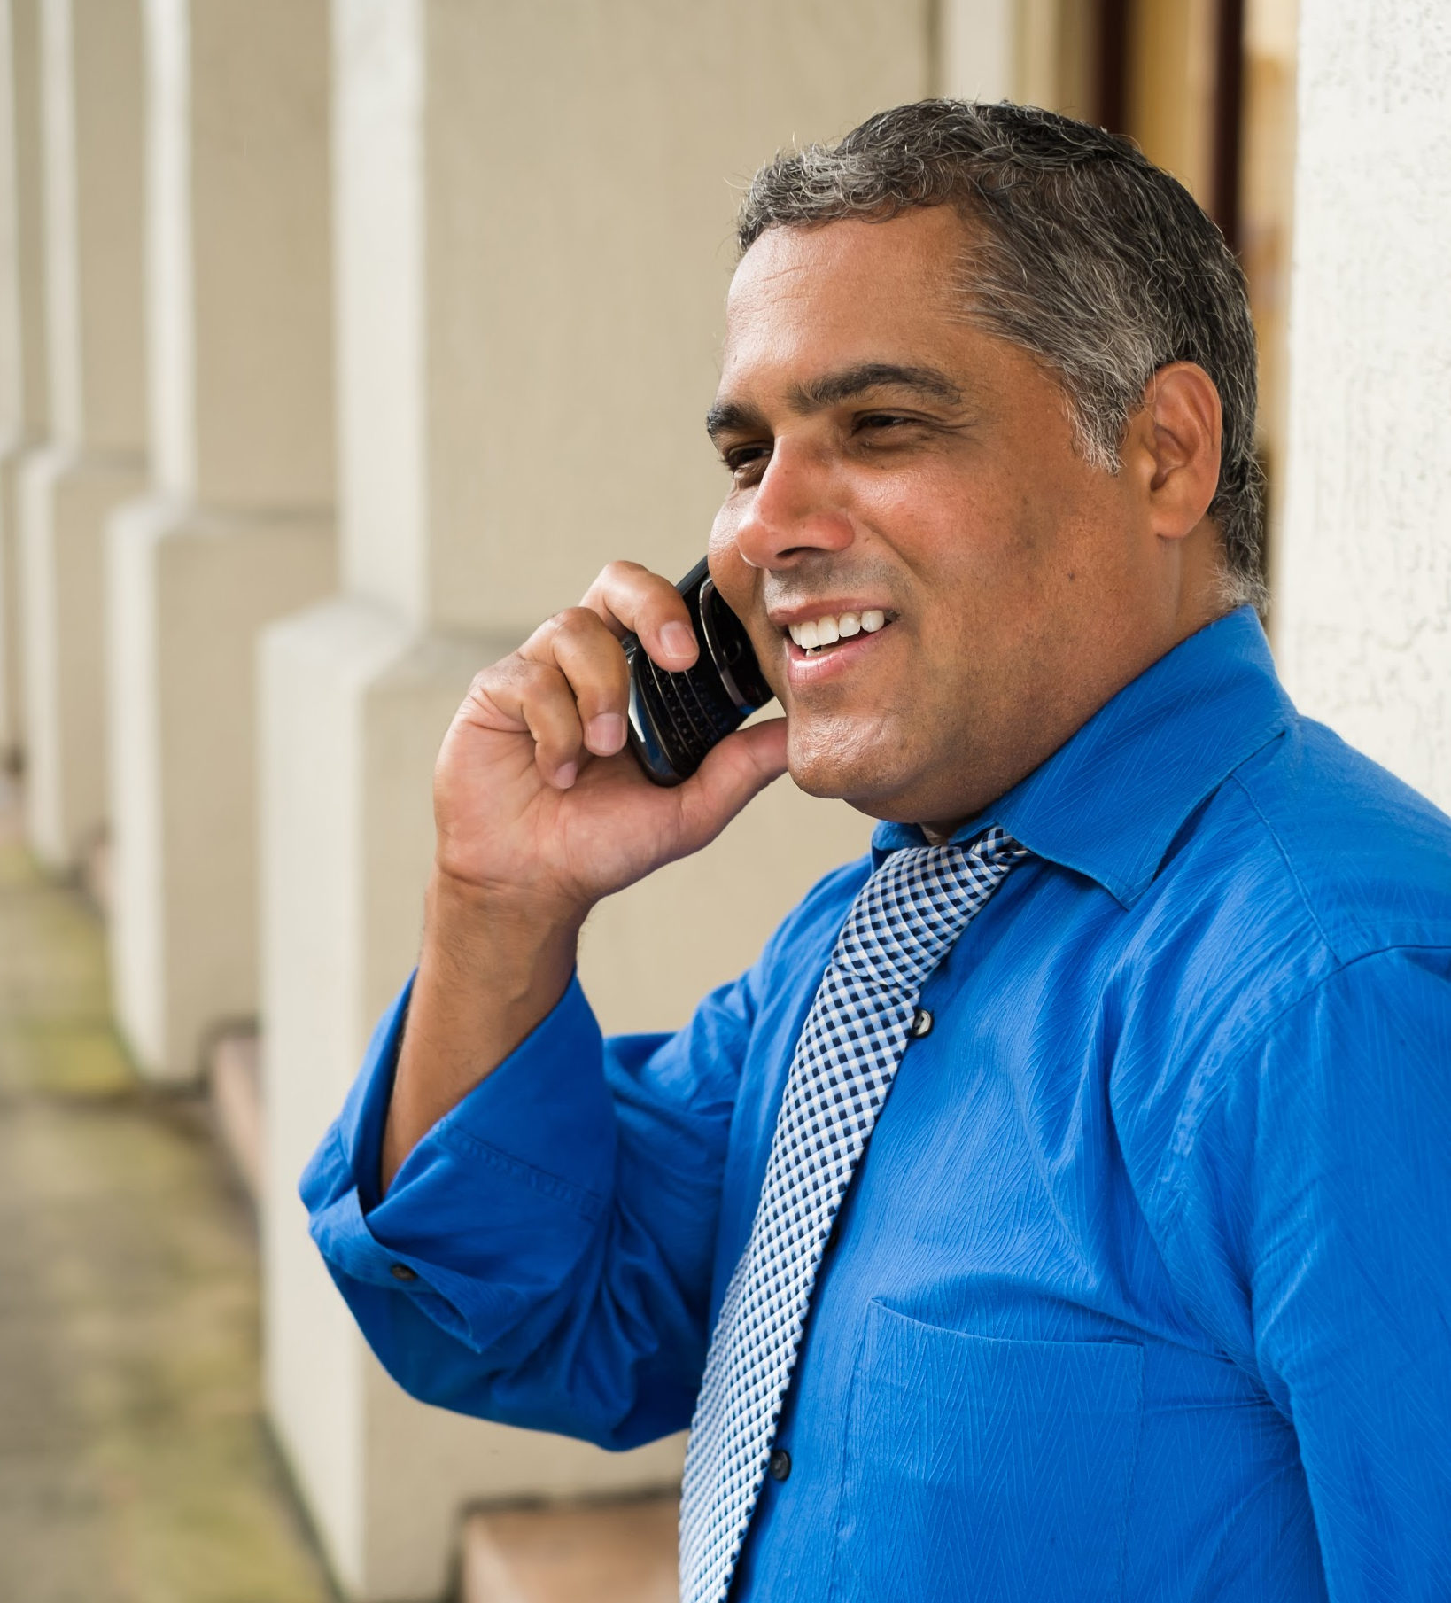
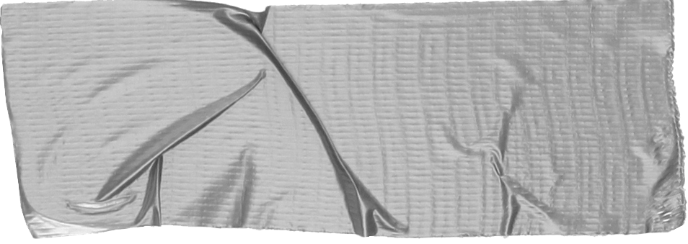

Meet Marcos.
He recently opened a camera shop near the Louvre in Paris.
Visitors to his store, mostly tourists, speak many different languages making anything beyond a simple transaction a challenge.
Tip
He calls Jesus whenever he has a problem.

